Slide 1


ECONOMIC,ENVIRONMENTAL AND SOCIETAL ISSUES IN MATERIAL SCIENCE AND ENGINEERING
Oscar Montoya JASSO
1815105
MATERIAL SCIENCE AND ENGINEERING

Slide 2
ECONOMIC CONSIDERATION
In order to reduce product costs, materials engineers should consider these three factors:
Component design
Material selection
Manufacturing technique

Slide 3


Component design
In this context, component design is the specification of size, shape, and configuration, which will affect in-service component performance

Slide 4
Material selection
The designer of any product (other than software) must get involved with material selection.
It involves seeking the best match between the property-profiles of the materials and that required by the design.

Slide 5
Manufacturing technique
The entire manufacturing process will normally consist of primary and secondary operations depending on the type of materials used is the technique which will be applied.

Slide 6
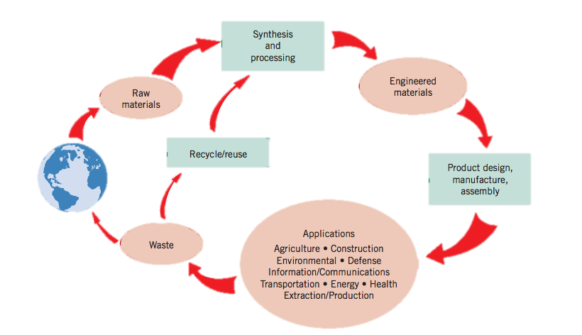
Materials’ Life Cycle

Slide 7
Issues
Raw material:
ecological damage and landscape spoilage
Synthesis and processing:
Pollutants may be generated that are expelled into the air and water.
Recycle/reuse:
Here the impact on the environment is minimal since some of them are made for recycling of its component materials

Slide 8
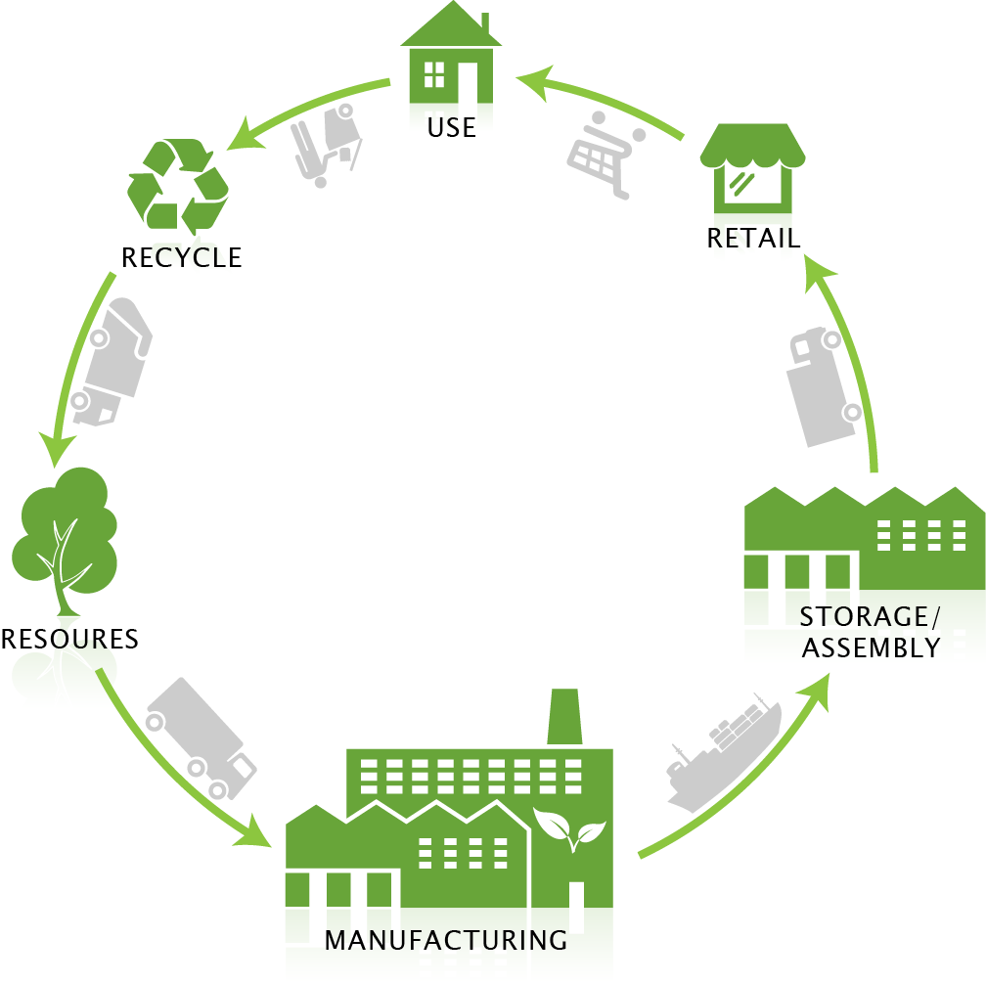
life cycle analysis/assessment
product design consideration is given to the cradle-to-grave environmental assessment of the product, from material extraction to product manufacture to product use, and, finally, to recycling and disposal; sometimes this approach is also labeled “green design.”

Slide 9
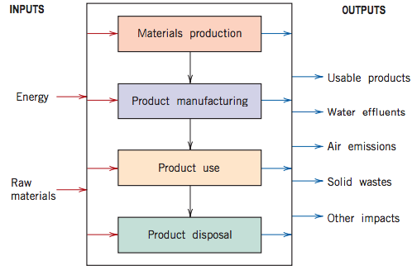
Inputs and outputs

Slide 10
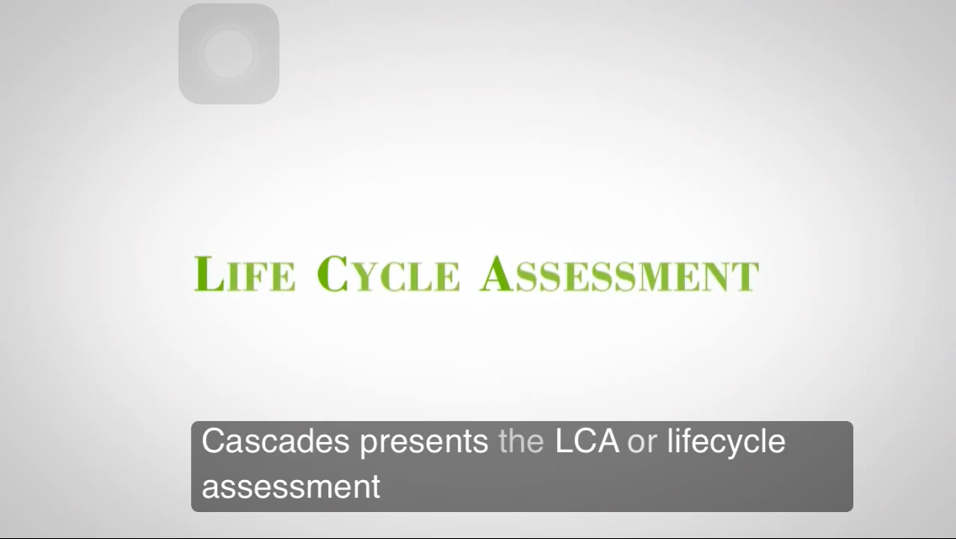

Slide 11
Recyclability/disposability issues
1.METALS: Most metals alloys experience corrosion and are also biodegradable (i.e., Fe, Cu). And some metals (i.e., Hg, Pb) are toxic and may present health hazards.
2.Glass: Glass is a relatively inert material, and, as such, it does not decompose, however it must be sorted by color, type and composition.
3. Plastics and Rubber: Polymers are not biodegradable, and, as such, they constitute a significant land-fill component; , since some polymers are combustible and do not yield appreciable toxic or polluting emissions, they may be disposed of by incineration.
4. Composite materials: Composites are inherently difficult to recycle because they are multiphase in nature. The two or more phases/materials that constitute the composite are normally intermixed on a very fine scale and trying to separate them complicates the recycling process

Slide 12
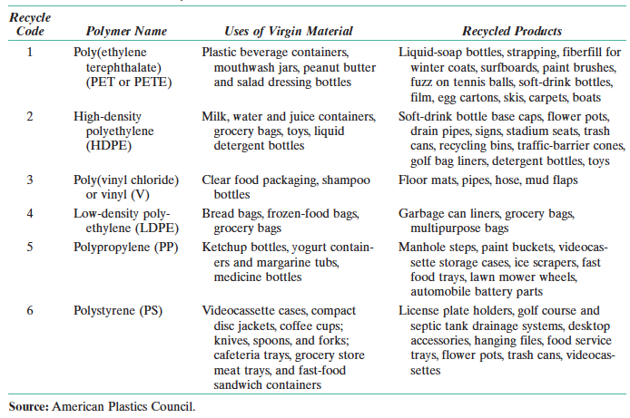

Slide 13
REFERENCES:
William D. Callister. (2013). Materials Science and Engineering An Introduction. United States of America : John Wiley and Sons. https://abmpk.files.wordpress.com/2014/02/book_maretial-science-callister.pdf
https://www.youtube.com/watch?v=7u5mQwREN6Y
http://www.foxnews.com/tech/2017/09/26/apples-iphone-8-heres-how-much-it-really-costs-to-build.html

